Slide 1

Dr Mahalingam College of Engineering & Technology
Department of Computer Science and Engineering 19CSPN6601- Innovative and Creative Project
Third Review
Title: HEART DISEASE PREDICTION
USING MACHINE LEARNING ALGORITHMS
Team Number: 22BCSA015
Team Member(s): 19BCS089 - G. Shangavie
19BCS093 - R. Nikesh
19BCS107 – V.Veeraraghavan
Faculty Supervisor: K. Prabhu, AP/CSE
Date: 11/06/2022

Slide 2
Contents
Domain Introduction
Problem description
Objective
Literature Survey
Design (Block Diagram)
Module Description
Screenshots
Hardware /Software Requirements
Reference(s)
Online Course Details
Project Content identified/ Journal Identified

Slide 3
Domain Introduction
Machine learning disease prediction is a system that predicts diseases based on information provided by users using various suitable algorithms. In recent times, Heart Disease prediction is one of the most complicated tasks in the medical field. In the modern era, approximately one person dies per minute due to heart disease. Data science plays a crucial role in processing huge amount of data in the field of healthcare.

Slide 4
Problem Description
As heart disease prediction is a complex task, there is a need to automate the prediction process to avoid risks associated with it and alert the patient well in advance. This Heart Disease Prediction Using Machine Learning is completely done with the help of Machine Learning algorithms and Python Programming language with and also using the dataset that's available previously by the hospitals using that we'll predict the disease.

Slide 5
Problem Description
The model is developed using classification algorithms, as they play important role in prediction. The proposed work predicts the chances of Heart Disease and classifies patients’ risk levels by implementing different machine learning techniques such as Logistic Regression, Random Forest, Support vector machine, Gaussian Naive Bayes, K-Nearest Neighbours, and Decision trees.

Slide 6
Objective
The main objective of this project is to get a better accuracy to detect heart disease using a combination of algorithms in which the target output counts whether a person has heart disease or not. This in turn will help to provide effective treatment to patients and avoid severe consequences.

Slide 7
Literature Survey 1
Author: Jayshril S. Sonawane
Title: Prediction of heart disease using multilayer perception neural network
Description: The accuracy by using this technique is 80%. Since the time complexity will be more due to usage of complex Boolean functions while using limited data sets for training, independently trained subnetworks scale quite well.

Slide 8
Literature Survey 2
Author: Ketut Agung Enrico
Title: heart disease prediction using KNN algorithm with simplified parameters.
Descripition: The accuracy of this algorithm is 81.85%. Using KNN, with the increase of the number of parameters the performance decreases and it considers 90% of data for training which is computationally expensive and does nothing during.

Slide 9
Literature Survey 3
Author: M.Akhil jabbar
Title: heart disease prediction using Lazy Associative classification.
Description: The vast amount of space used to store the entire data collection. Since no abstraction is made during the training phases, especially noisy training data increases the case base unnecessarily.

Slide 10
Literature Survey 4
Author: Jaymin Patel
Title: prediction of heart disease using data mining techniques
Description: The accuracy is 56.76%. The drawback of J48 is that the tree increases linearly with large data. LMT is slower and takes long time for implementation and accuracy is low.

Slide 11
Literature Survey 5
Author: Rifki wijaya
Title: preliminary design of estimating heart disease by using machine learning ANN within one year
Description: The accuracy is 81.85%. To function, the neural network needs to be trained. Big neural networks necessitate a long processing time. Microprocessor design and history necessitate their emulation

Slide 12
Literature Survey 6
Author: Carlos Ordonez
Title: proposed association rules to implement this prediction system
Description: The accuracy is 70%. It uses too many parameters from patients record and produce irrelevant rules. So, this technique is computationally expensive and performance is low.

Slide 13
Literature Survey 7
Author: Jyoti soni
Title: evaluation of Weighted Associative Classifier (WAC).
Description: All attributes are not equally important in predicting the class mark in the prediction model. As a result, various weights may be allocated to different attributes based on their ability to predict.

Slide 14
Literature Survey 8
Author: Idticeme sedjelmaci
Title: al proposed detection of some heart diseases using fractal dimension and chaos theory
Description: The accuacy of this technique is 80%. Fractal analysis was created to analyse complex irregular objects. The drawbacks of applying Chaos Theory are primarily due to the input parameters chosen. The methods used to compute these parameters are determined by the underlying dynamics of the data as well as the type of analysis being performed, which is usually complex and not always precise.

Slide 15
Literature Survey 9
Author: D.R.Patilet
Title: prediction of heart disease using learning vector quantization algorithm
Description: The accuracy of this algorithm is 85.55%. There is no limit to the number of prototypes that can be used per class; the only requirement is that each class have at least one prototype

Slide 16
Literature Survey 10
Author: AH Chen
Title: heart disease prediction system that can help doctors predict heart disease status using patient clinical data
Description: The C language is used an artificial neural networks for classification and prediction of heart disease. The C and C# programming languages are used to develop system.The proposed method accuracy is 80%. m.

Slide 17
Literature Survey 11
Author: Anbarasi
Title: proposed prediction of heart disease with feature subset selection using genetic algorithm
Description: The accuracy is 70%. The language used to specify candidate solution must be robust.

Slide 18
Literature Survey 12
Author: Manpreet Singh
Title:cardiovascular disease prediction system based on structural equation modelling (SEM) and Fuzzy cognitive map (FCM) (2016)
Description:The accuracy of SEM and FCM 74%. It doesn’t work well with large data and accuracy is low. Kathleen j.

Slide 19
Literature Survey 13
Author: Miao
Title: heart disease diagnosis using Deep Neutral Network(2015)
Description: The accuracy is 83.67%. It is difficult to be adopted by people who are less experienced. It is difficult to comprehend performance based solely on understanding, and this necessitates the use of classifiers.

Slide 20
Literature Survey 14
Author: Jae Kwon Kim
Title: neural network based coronary heart disease risk prediction using feature correlation analysis(2017).
Description: The accuracy of this is 81.163%. A correlational analysis can only be used when the variables are two measurable on scale. It's difficult to tell which variables cause which effects, and a high correlation between variables can be misleading. Sairabi H.

Slide 21
Literature Survey 15
Author: Mujawar ae Kwon Kim
Title: prediction of heart disease using modified K-means and Naïve Bayes(2015).
Description: Naive Bayes assumes that all predictors are independent and it also have zero frequency problem.

Slide 22
Design (Block Diagram)
Data Set
Attribute
Selection
Pre-Processing
Machine Learning Algorithms
( Logistic Regression, KNN, SVM, Naive Bayes, Decision Tree, Random Forest )
Patient Data
Prediction
Comparison
HEART DISEASE PREDICTION USING MACHINE LEARNING

Slide 23
Module Description
Modules Identified:-
Attribute Selection
Pre-Processing
Machine Learning Algorithms
Logistic Regression
KNN
SVM
Naive Bayes
Decision Tree
Random Forest
Prediction

Slide 24
Attribute Selection
An attribute selection measure is a heuristic for choosing the splitting test that “best” separates a given data partition, D, of class-labeled training tuples into single classes.
If it can split D into smaller partitions as per the results of the splitting criterion, ideally every partition can be pure (i.e., some tuples that fall into a given partition can belong to the same class).
Conceptually, the “best” splitting criterion is the most approximately results in such a method. Attribute selection measures are called a splitting rules because they decides how the tuples at a given node are to be divided.
The attribute selection measure supports a ranking for every attribute defining the given training tuples. The attribute having the best method for the measure is selected as the splitting attribute for the given tuples.

Slide 25
Pre-Processing
Data preprocessing is a process of preparing the raw data and making it suitable for a machine learning model. It is the first and crucial step while creating a machine learning model.
When creating a machine learning project, it is not always a case that we come across the clean and formatted data. And while doing any operation with data, it is mandatory to clean it and put in a formatted way. So for this, we use data preprocessing task.

Slide 26
Machine Learning Algorithms
Heart disease predicting model is trained by using the Cleveland dataset which takes age, gender, chest pain, resting blood pressure, rest ECG, maximum heart rate, exercise including angina, ST depression, ST slope, number of major blood vessels, types of thalassemia as inputs and produce output stating whether the patient is suffering from heart disease or not.
If only a single algorithm is used it cannot Pre-Process data and even it can’t get good accuracy. So it’s better to have a combination of algorithms like “Logistic Regression”, “KNN”, “SVM”, “Naive Bayes”, “Decision Tree”, and "Random Forest“.
A lot of work has been carried out to predict heart disease using the Machine Learning dataset. Different levels of accuracy have been attained using various data mining techniques. This Project “Heart Disease Prediction using Machine Learning algorithms” is implemented using python completely.

Slide 27
Prediction and Comparision
Prediction” refers to the output of an algorithm after it has been trained on a historical dataset and applied to new data when predicting the likelihood of a particular outcome.
The key to a fair comparison of machine learning algorithms is ensuring that each algorithm is evaluated in the same way on the same data you can achieve this by forcing each algorithm to be evaluated on a consistent test harness.
In the example below 6 different algorithms are compared:
Logistic Regression
Linear Discriminant Analysis
K-Nearest Neighbors
Classification and Regression Trees
Naive Bayes
Support Vector Machines

Slide 28
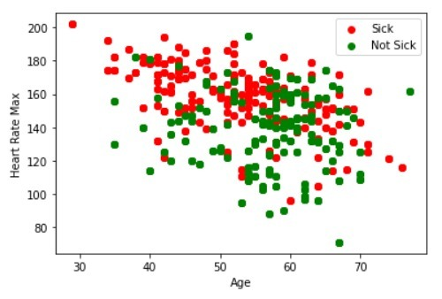
Screenshots:
Plot Graph of the Output

Slide 29
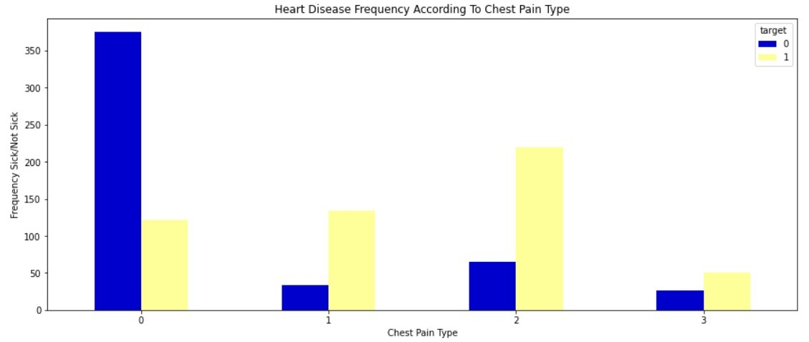
Screenshots:
Heart Disease Frequency According to Chest Pain

Slide 30
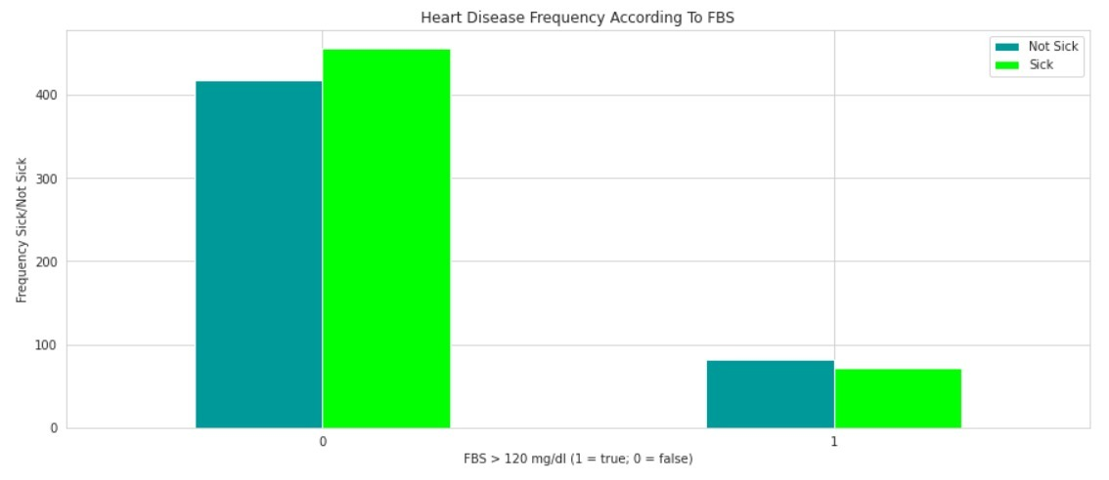
Screenshots:
Heart Disease Frequency According to FBS

Slide 31
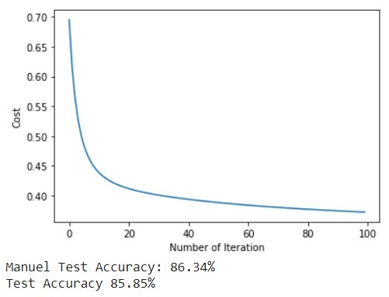
Screenshots:
Accuracy Rate Testing

Slide 32
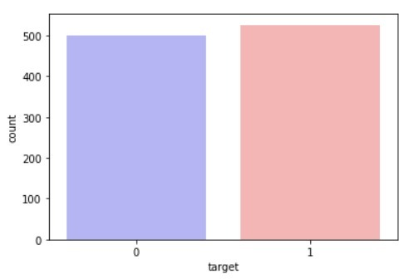
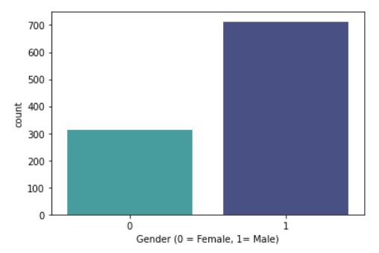
Screenshots:
No.of Patients Affected/Not Affected

Slide 33
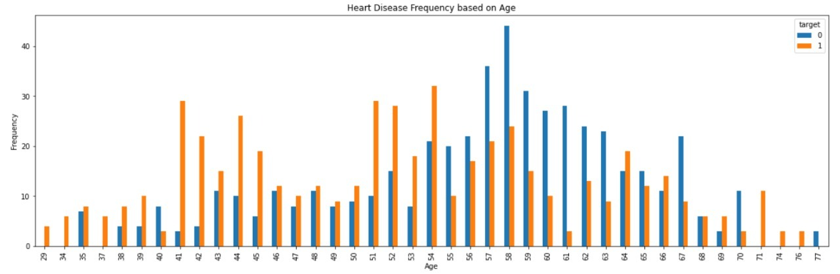
Screenshots:
Heart Disease Frequency based on Age

Slide 34
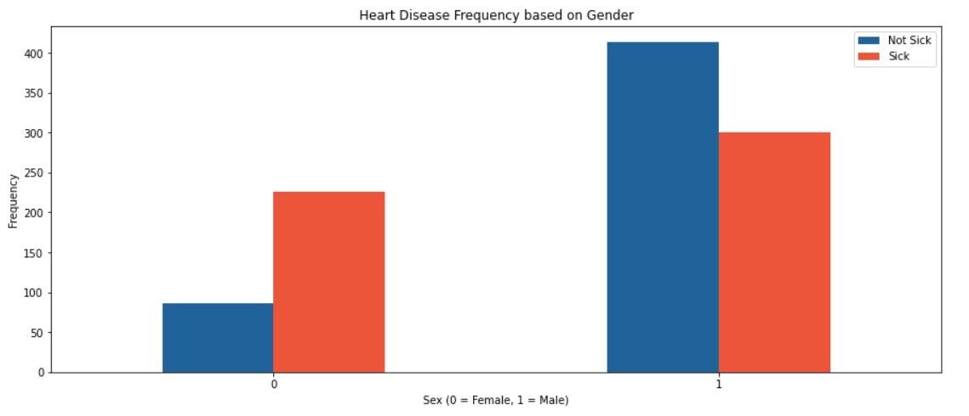
Screenshots:
Heart Disease Frequency based on Gender
Gender(0=Female, 1=Male)

Slide 35
Screenshots:
Heart Disease Frequency According to Chest Pain Type

Slide 36
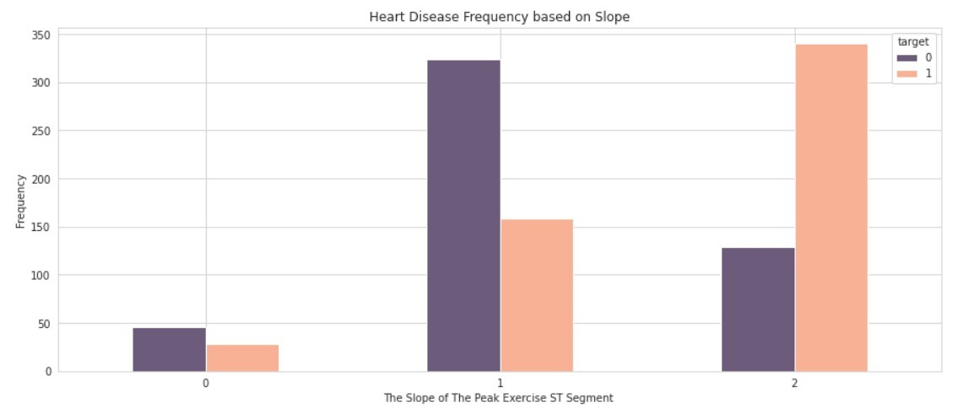
Screenshots:
Heart Disease Frequency based on ST slope

Slide 37
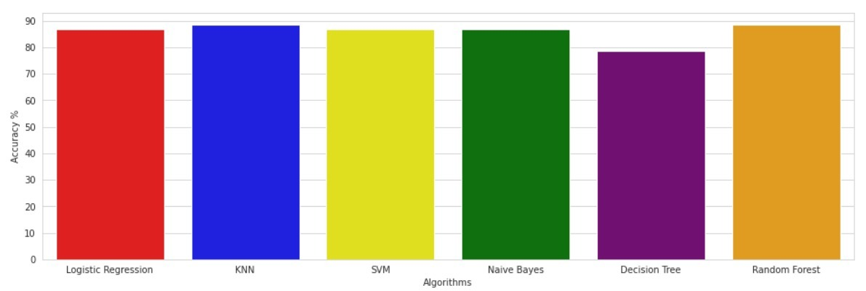
Screenshots:
Bar Graph for Heart Disease Accuracy by various Algorithms

Slide 38
Hardware and Software Requirements
Hardware requirements – Internet Connectivity Intel i5 Processor (min)
RAM – 4 GB (min)
Software Requirements – Google Collab

Slide 39
References
[1] Jayshril S. Sonawane, D.R Patil, 2014, “ Prediction Of Heart Disease Using Multilayer Perceptron Neural Network ”, IEEE International Conference on Information Communication and Embedded Systems (ICICES2014).
[2]I Ketut Agung Enriko, Muhammad Suryanegara,Dinda Agnes Gunawan, “ Heart disease prediction system using k-Nearest neighbor algorithm with simplified patient's health parameters”, 2016.
[3] M. Akhil Jabbar; B. L Deekshatulu; Priti Chandra, “ Heart disease prediction using lazy associative classification”, : 2013, IEEE International Mutli-Conference on Automation, Computing, Communication, Control and Compressed Sensing (iMac4s).
[4] Jaymin Patel, Prof. Tejal Upadhyay, and Dr. Samir Patel, Sep 2015-Mar 2016, “Heart Disease Prediction using Machine Learning and Data Mining Technique”, Vol. 7, No.1, pp. 129-137.
[5] Rifki Wijaya, ArySetijadiPrihatmanto, Kuspriyanto, “ Preliminary design of estimation heart disease by using machine learning ANN within one year”, 2013, IEEE Joint International Conference on Rural Information & Communication Technology and Electric-Vehicle Technology (rICT&ICeV-T).

Slide 40
References
[6] Carlos Ordonez,2006, “Association Rule Discovery with the Train and Test Approach for Heart Disease Prediction”, IEEE Transactions on Information Technology in Biomedicine (TITB), pp. 334-343, vol. 10, no. 2.
[7] Jyoti Soni, Uzma Ansari, Dipesh Sharma, and SunitaSoni,June 2011, “Intelligent and Effective Heart Disease Prediction System using Weighted Associative Classifiers”, International Journal on Computer Science and Engineering (IJCSE), Vol. 3, No. 6, pp. 2385-2392.
[8] IbticemeSedielmaci; F. BereksiReguig, “ Detection of some heart diseases using fractal dimension and chaos theory”, 2013, IEEE 8th International Workshop on Systems, Signal Processing and their Applications (WoSSPA).
[9] Jayshril S. Sonawane; D. R. Patil, “ Prediction of Heart Disease Using Learning Vector Quantization Algorithm ”, 2014, IEEE Conference on IT in Business, Industry and Government (CSIBIG).
[10] AH Chen, SY Huang, PS Hong, CH Cheng, and EJ Lin,2011, “HDPS: Heart Disease Prediction System”, Computing in Cardiology, ISSN: 0276-6574, pp.557- 560.

Slide 41
References
[11] Anbarasi Masilamani, ANUPRIYA, N Ch Sriman Narayana Iyenger, “Enhanced Prediction of Heart Disease with Feature Subset Selection using Genetic Algorithm”, October 2010, International Journal of Engineering Science and Technology 2(10).
[12] Manpreet Singh, Levi Monteiro Martins, Patrick Joanis, and Vijay K. Mago,2016, “Building a Cardiovascular Disease Predictive Model using Structural Equation Model & Fuzzy Cognitive Map”, IEEE International Conference on Fuzzy Systems (FUZZ), pp. 1377-1382.
[13] Kathleen H. Miao, Julia H. Miao, “Coronary Heart Disease Diagnosis using Deep Neural Networks ”,(IJACSA)International Journal of Advanced Computer Science and Applications, Vol. 9, No. 10, 2018 .
[14] Jae Kwon Kim and Sanggil, “Neural Network-Based Coronary Heart Disease Risk Prediction Using Feature Correlation Analysis”, 2017.
[15] Sairabi H. Mujawar, and P. R. Devale, October 2015,“Prediction of Heart Disease using Modified k-means and by using Naive Bayes”, International Journal of Innovative Research in Computer and Communication Engineering(An ISO 3297: 2007 Certified Organization) Vol. 3, Issue 10, pp. 10265-10273.

Slide 42
References
[16] B Padmaja, V V Rama Prasad, K V N Sunitha (2016), “TreeNet analysis of human stress behavior using socio-mobile data,” in Journal of Big Data, 3(1), pp. 1-15, 2016, Springer.
[17] B Padmaja, Myneni Madhu Bala, E Krishna Rao Patro (2020), “A Comparison on visual prediction models for MAMO(multi activity multi-object) recognition using Deep Learning,” in Journal of Big Data, 7(24), pp. 1-15, Springer.
[18] B Padmaja, V V Rama Prasad, K V N Sunitha (2020), “ A Novel Random Split Point Procedure using Extremely Randomized Trees Ensemble Method for Human Activity Recognition,” in EAI Endorsed transactions on Pervasive Health and Technology, 6(22), PP. 1-10.
[19] B Padmaja, V V Rama Prasad, K V N Sunitha (2018), “Machine Learning Approach for Stress Detection using Wireless Physical Activity Tracker,” in International Journal of Machine Learning and Computing, 8(1), pp. 33-38.

Slide 43
Online course details
S.No | Course Title with Duration | Platform | Status
19BCS089 | Machine Learning A-Z: Become Kaggle Master | Udemy | COMPLETED
19BCS093 | Complete Machine Learning & Data Science Bootcamp 2022 | Udemy | COMPLETED
19BCS107 | Machine Learning A-Z™: Hands-On Python & R in Data Science | Udemy | COMPLETED

Slide 44

Online course Certification

Slide 45

Online course Certification

Slide 46

Online course Certification

Slide 47
Project Contest / Journals Identified
[1]IJRAR – International Journal of Research and Analytical Reviews
International Journal of Research and Analytical Reviews (IJRAR) is a Leading high quality open access & peer reviewed quarterly published research journal.
International Journal of Research and Analytical Reviews (IJRAR) is a Leading high quality open access & peer reviewed quarterly published research journal. IJRAR is providing a platform for the researchers, academicians, professional, practitioners and students to impart and share knowledge in the form of high quality empirical and theoretical research papers, case studies, literature reviews and book reviews.

Slide 48
Thank You!

